Slide 1
Presentation 1
The software quality challenge
The uniqueness of software quality assurance
The environments for which SQA methods are developed
Notes:
指在哪種環境下要 SQA?

Slide 2
The uniqueness of the software
development process
High complexity
Invisibility of the product
Limited opportunities to detect defects (“bugs”)
Notes:
aaaa

Slide 3
The characteristics of the
SQA environment process
Being contracted
Subjection to customer-supplier relationship
Requirement for teamwork
Need for cooperation and coordination with other development teams
Need for interfaces with other software systems
Need to continue carrying out a project while the team changes
Need to continue maintaining the software system for years

Slide 4
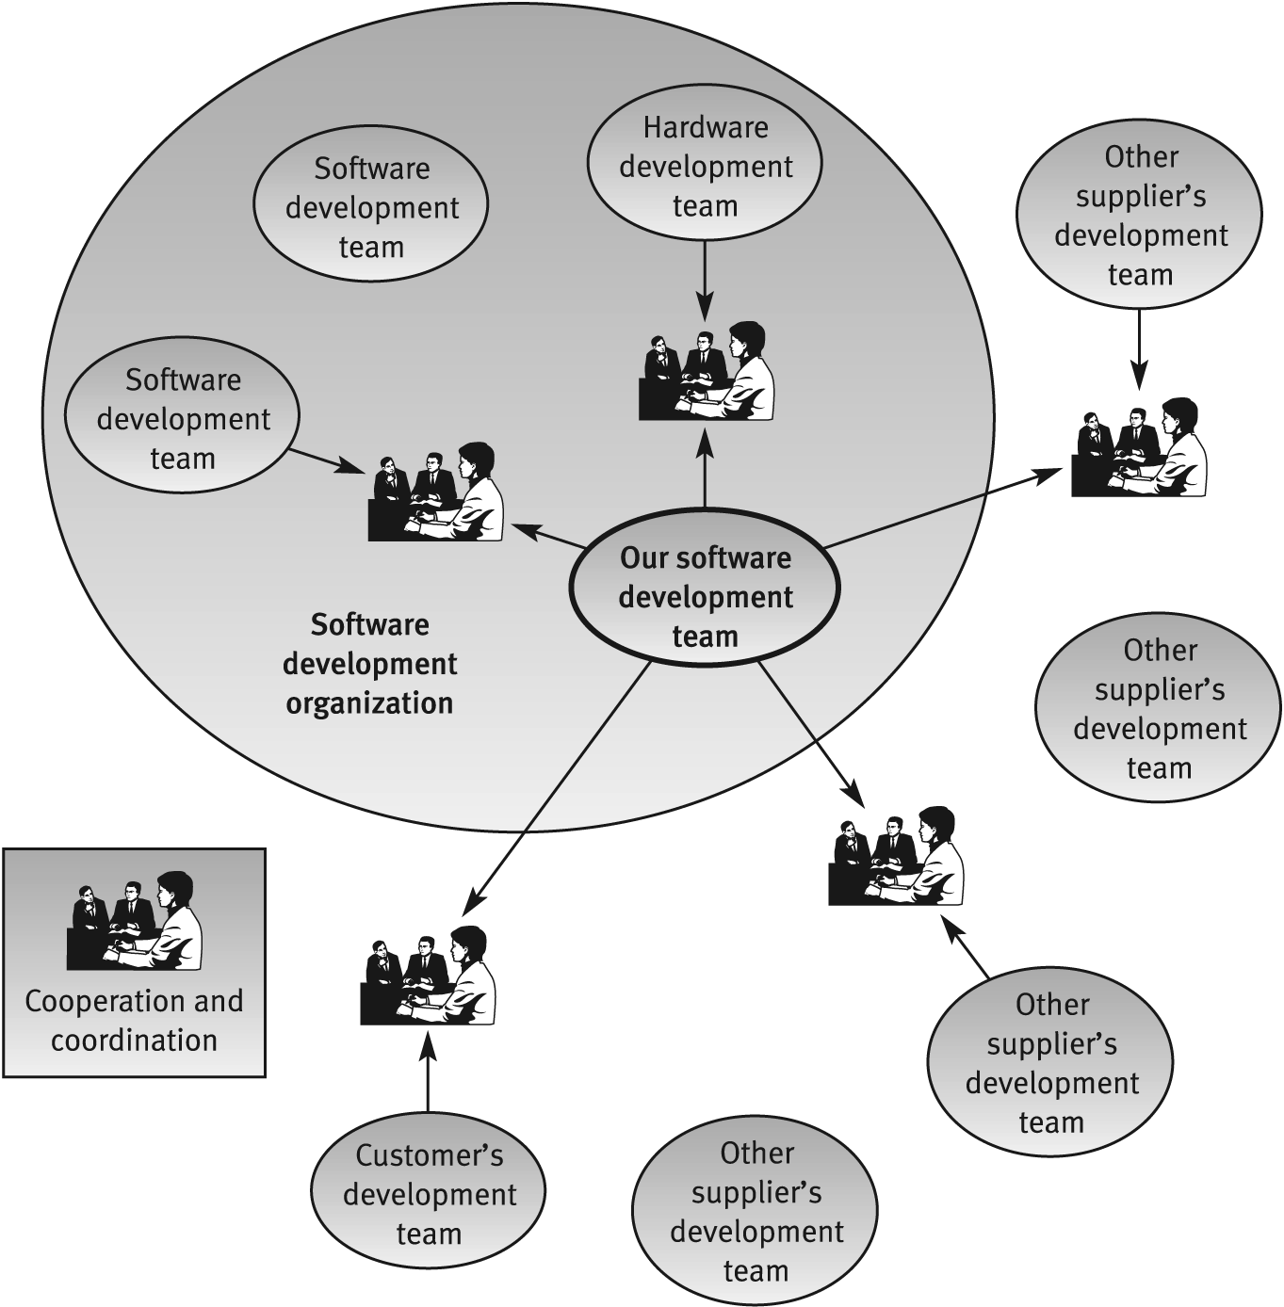
Cooperation and coordination
scheme for a software
development project team

Slide 6
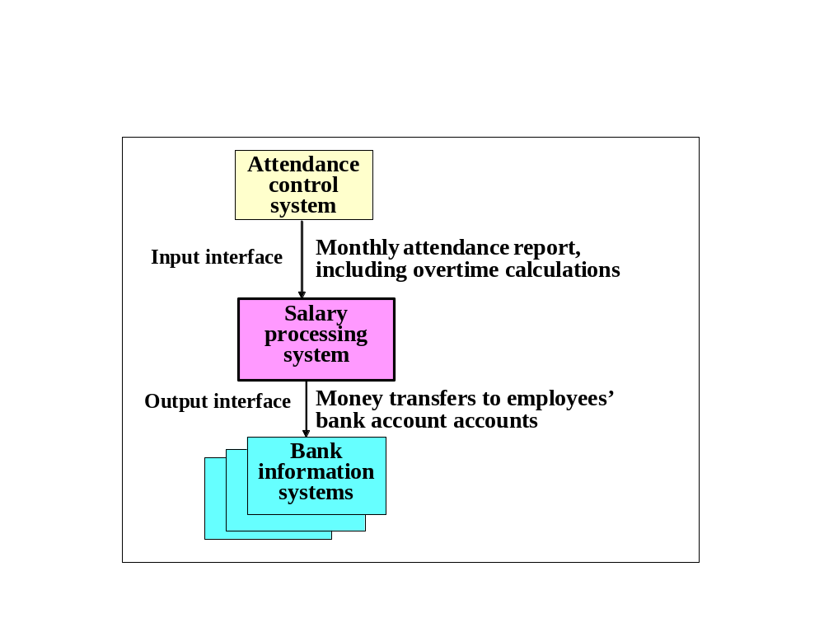
Salary software system - an
example of software interfaces

